Slide 1
Notes:
I’m going to start this talk in a rather unusual way.
I’m going to start with what I am NOT going to be talking about.
That’s because a couple of things are so important that I wanted to mention them anyway (even though I won’t have time to go into them in depth).

Slide 2
Children do NOT need basic literacy skills to be ready for school.

Slide 3
They need basic language skills,
ORAL LANGUAGE, to be ready for school.

Slide 4
Children need early EDUCATION.
At the ages of 3-5 they need
active, hands-on learning, play
They do NOT need early
ACADEMIC INSTRUCTION
at ages 3-5.
Notes:
This is important because little kids are not built to sit still for any length of time listening to verbal instruction,
esp. little boys.
Trying to make young children do that
will cause many children to dread school &
to form long-lasting perceptions of themselves as stupid & unable to learn.

Slide 5
Notes:
In a recent analysis of student outcomes worldwide,
THE TWO COUNTRIES THAT
CAME OUT ON TOP WERE
Finland & South Korea,
& that’s consistent with what
other research has found

Slide 6
What do Finland and South Korea
have in common?
Not much, but in both countries…
The standards for getting into teacher training at univ. are extremely high.
The respect for teachers is enormous.
Teachers are paid extremely well.
Notes:
So high, that some of those who can’t get in, go into what I do – they go into research
Think about it –
To get the best student outcomes…
We need to attract the best and brightest to go into teaching, &
we need to respect them and compensate them accordingly.

Slide 7
What abilities and skills will be needed for success in the 21st century?
Notes:
Now, I’ll turn to the topic of my talk….

Slide 8
1) Self-control
Having the self-control to resist temptations
and not act impulsively
Notes:
thinking before you speak or act
so you don’t do something you’d regret or put your foot in your mouth
having the self-control to wait before making up your mind
– not jumping to a conclusion or pre-judging

Slide 9
2) Discipline & Perseverance
Having the discipline
to stay on task
and complete it
Notes:
resisting the temptation to quit because
you’re frustrated,
bored, or
tempted by things that would be far more fun
continuing to work even though
the reward may be a long time in coming

Slide 10
Creativity in seeing connections between seemingly unconnected ideas or facts
Notes:
Playing with information & ideas in your mind,
relating one to another,
then dis-assembling those combinations
and re-combining the elements in new ways.
Working Memory involves holding info in mind & working with it.
It’s critical for reasoning

Slide 11
4) Creativity in seeing familiar things in new ways,
from different perspectives
Notes:
If one way of solving a problem isn’t working,
CAN WE CONCEIVE of the problem in a different way?
CAN WE THINK OUTSIDE THE BOX
to come up with a different way of attacking the problem?

Slide 12
and finally….
5) Flexibility
Notes:
Having the flexibility
… to take advantage of serendipity
… navigate around unforeseen obstacles, &
… admit we were wrong when we get more info

Slide 13
Notes:
“Executive Functions” is shorthand
for ALL of the abilities I just mentioned
and,
EFs just happen to be my specialty

Slide 14
Notes:
EFs are important for every aspect of life –
success in school, success in the workplace,
making & keeping friends, marital harmony, &
avoiding things like premature pregnancy, substance abuse, or driving fatalities
In other words, self-control,
CREATIVITY, REASONING, MENTAL FLEXIBILITY,
discipline and perseverance are really important
– THEY ARE OFTEN more predictive than IQ.

Slide 15
If you want your child to do well in school & in life, help your child develop healthy exec. functions.

Slide 16
The good news is that Executive Functions
can be improved.

Slide 17
In fact, it turns out that many different activities have been shown to improve EFs, including…
computerized training,
games,
aerobics,
traditional martial arts,
yoga,
mindfulness, &
certain school curricula (like Tools of the Mind, Montessori, and PATHS).

Slide 18
I predict that the activities that will most successfully improve EFs will not only work on training and improving EFs but will also indirectly support EFs by lessening things that impair EFs and enhancing things that support EFs.

Slide 19
Notes:
What things impair
& what things support EFs?

Slide 20
Notes:
EFs depend on PFC &
the other neural regions with which it is interconnected

Slide 21
Notes:
PFC is the newest area of the brain
& the most vulnerable

Slide 22
If you’re
• sad or stressed
• lonely
• sleep-deprived, or
• not physically fit
PFC & EFs are the first to suffer,
& suffer THE MOST.

Slide 23
Notes:
Stress impairs EFs
& can cause anyone to look AS IF
he or she has an EF impairment
(like ADHD)
when that’s not the case at all.
(You may have noticed that when YOU’RE stressed
you can’t think as clearly or exercise as good self-control.)
When I’m stressed, I reach for the chocolate.

Slide 24
Notes:
If you’re stressed,
you can’t be the teacher or parent
you want to be.

Slide 25
Notes:
You need to be able to RELAX.
Don’t get all stressed &
down on yourself
for not being the perfect parent.
Remember:

Slide 26
Imperfect ≠ Worthless

Slide 27
Notes:
Even the people
you most respect
make mistakes
& have done things they regret.
EVERYONE makes mistakes.
EVERYONE is to be imperfect.
YET each of us is wonderful in our own way – despite being imperfect.
And you can be a TERRIFIC parent even though you’re not the perfect parent.

Slide 28
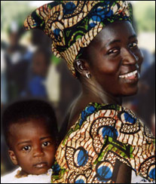
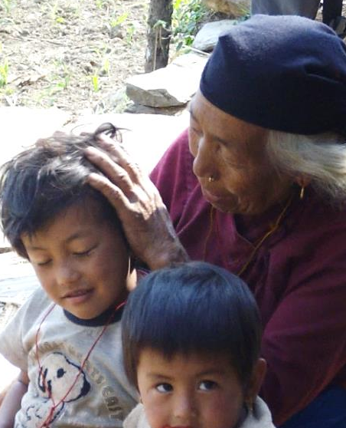
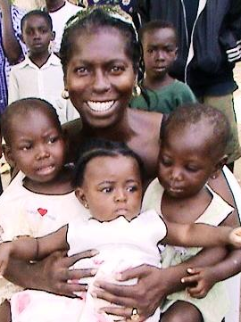
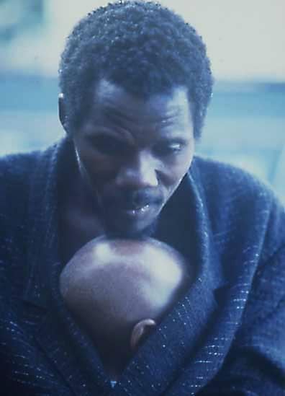

Your humanity is more important than your knowledge or skill or doing the textbook-perfect thing.

Slide 29
Notes:
Your caring -- your openness to truly listen;
being there for your child
when he or she needs you
is more important than
your knowledge or skill.

Slide 30
Notes:
One major source of stress
for many children
is feeling that they’re
stupid, can’t learn,
and will never succeed…

Slide 31
It’s important to communicate loud and clear the faith and expectation that each child will succeed.

Slide 32
Notes:
When a toddler falls while trying to walk,
we would never say, “you get a ‘D’ in walking today”;
it would never occur to us!!
Instead we say, “Don’t worry; I’m sure you’re going to be able to do this.”

Slide 33
Notes:
How different is that from what children hear in school.
They hear: “You get a D”
rather than “There’s no question you’re going to be able to do this.
And we, TOGETHER, are going to figure out a way to make that happen.”

Slide 34
A school in BC
has as its motto:
If you can’t learn the way we teach, we will teach the way you learn.
Notes:
How terrific is that?!!

Slide 35
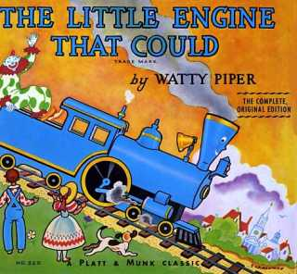
Children need to believe in
themselves.

Slide 36
Notes:
For ex., there’s a stereotype in our culture that men are better in math than women.
And sure enough when a group of researchers went to a univ. & gave a standardized math test,
As a group, the male students scored higher than the female students.
Then the researchers tested another group of
entirely comparable university students on exactly the same test
– the ONLY difference was they added one sentence before giving the exam.
They said, “This particular test has been designed to be gender-neutral;
on this particular test women score as well as men.”

Slide 37
Notes:
And what happened? The women scored as well as the men.
It was the SAME test as the first group got.
The only difference was WHETHER THE WOMEN EXPECTED themselves to do well or not.
OUR EXPECTATIONS FOR OURSELVES
often become self-fulfilling prophecies

Slide 38
Notes:
Many children are so terrified
of making a mistake
they’re afraid to try anything new.

Slide 39
Notes:
Making a mistake is NOT the worst thing in the world.
WE NEED TO LET CHILDREN KNOW it’s okay to make mistakes; EVERYONE makes mistakes.
The only alternative is to STAY WITH WHAT YOU ALREADY KNOW,
to stop growing.

Slide 40
Notes:
The important thing
is HOW YOU REACT
after you’ve made a mistake
or fallen short of a goal.

Slide 41
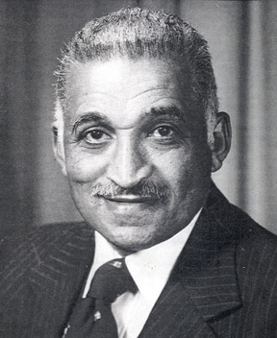
You've never failed until you've tried for the
last time, and you've never lost until you quit.
-- Samuel Proctor Massie
It’s never over ‘til it’s over

Slide 42
Notes:
Samuel Proctor Massie was born in the segregated South in the early 1900’s.
You KNOW he encountered a lot of discrimination, setbacks, and failures.
Yet he rose to become one the most highly respected and decorated chemists of the 20th century.
YOU HAVEN’T FAILED UNTIL you’ve stopped trying.

Slide 43
Notes:
If children are afraid TO TRY SOMETHING NEW,
afraid they’ll be penalized for a mistake…
We need to show them they’ll be REWARDED for trying.
If what gets graded is what children see as important,
then we need to reward them with an ‘A’ UNDER A NEW CATEGORY --
THE COURAGE TO TRY SOMETHING NEW, to risk being wrong.

Slide 44
Notes:
Let’s return to what things impair
and what things SUPPORT EFs.

Slide 45
Our brains work better when we’re not feeling lonely or socially isolated.
Loneliness: Human Nature and
the Need for Social Connection
2008
a book by John Cacioppo & William Patrick
That is particularly true for PFC & EFs.

Slide 46
Notes:
In one study, researchers told a group of subjects that they’d have close relationships throughout their lives;
- they told another group the opposite; &
- told a third group unrelated bad news.
On simple memorization questions (that don’t require EFs) the groups were comparable.
On logical reasoning (that requires EFs),
those told to expect that they’ll be lonely performed worse.

Slide 47
Notes:
Other researchers haven’t tried to manipulate this,
they simply give subjects a survey when they come in the lab
& THAT INCLUDES questions like
‘Do you feel socially supported? Do they feel lonely?’
ONE RESEARCH GROUP found that PFC FUNCTIONED
less efficiently in those who felt lonely or isolated.

Slide 48
Notes:
We are FUNDAMENTALLY SOCIAL.
We need to belong.
We need to fit in & BE LIKED.
Children who ARE LONELY or ostracized
will have more difficulty learning.

Slide 49
Notes:
It’s not just peers; a close relationship with a caring adult can be HUGE.

Slide 50
Our brains work better when our bodies are physically fit.
Nature Reviews Neuroscience (January 2008)
“Be Smart, Exercise Your Heart:
Exercise Effects on Brain and Cognition”
Charles Hillman, Kirk Erickson & Art Kramer
“There is little doubt that leading a sedentary life
is bad for our cognitive health.”
That is particularly true for PFC & EFs.
Notes:
and….

Slide 51
Notes:
The brain doesn’t recognize the same sharp div. betw. cog. & motor func.
that we impose in our thinking.
The same or substantially overlapping brain systems
subserve BOTH cog. & motor func.

Slide 52
Notes:
For ex., the area of the brain known as the PRE-SMA
is important for sequential tasks.
It doesn’t matter whether
they’re sequential motor tasks
or sequential cog. tasks.

Slide 53
The different parts of the human being are fundamentally interrelated.
Each part (cognitive, social, emotional, & physical) is affected by, and affects, the other parts.
Diamond, 2000

Slide 54
Let’s return to my prediction:
Those activities that most successfully improve executive functions should not only work on training and improving executive functions
but also….

Slide 55
indirectly support executive functions by working to reduce things that impair executive functions and working to enhance things that support executive functions.

Slide 56
What activities directly
train and challenge
executive functions and indirectly support them by also addressing our social, emotional, and physical needs?

Slide 57
Notes:
Traditional Activities that have been around for millennia.

Slide 58
Notes:
For 10's of 1,000's of yrs, across all cultures,
storytelling, DANCE, ART, MUSIC & PLAY have been part of the human condition.
People in all cultures
MADE MUSIC, SANG, DANCED, DID SPORTS, AND PLAYED GAMES.
There are good reasons why those activities HAVE LASTED SO LONG & arose everywhere.

Slide 59
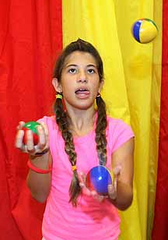
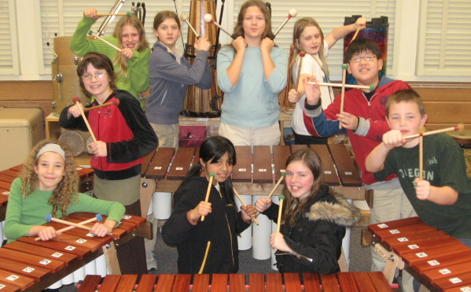
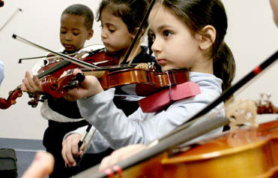
Certainly they help develop motor skills such as bimanual and eye-hand coordination,

Slide 60
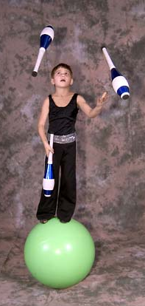
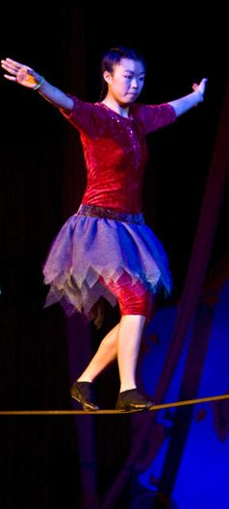

balance,

Slide 61
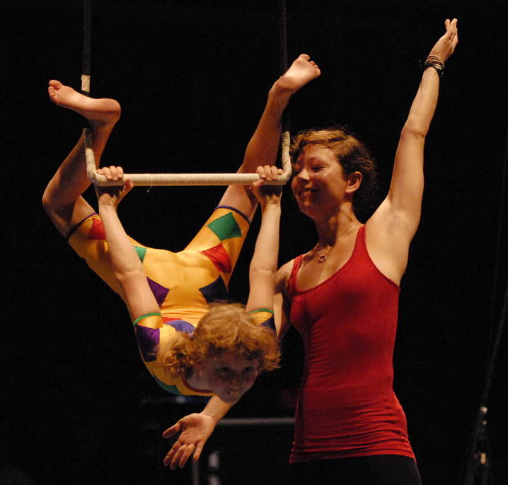
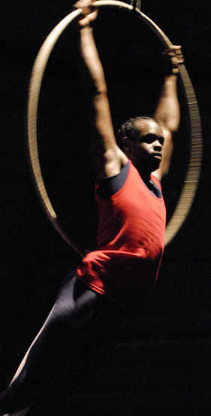
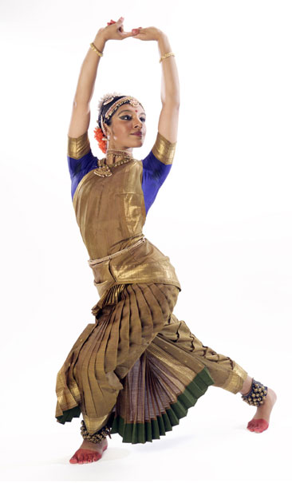
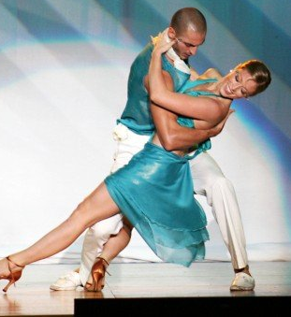
strength & flexibility

Slide 62

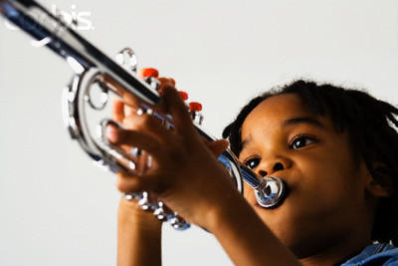
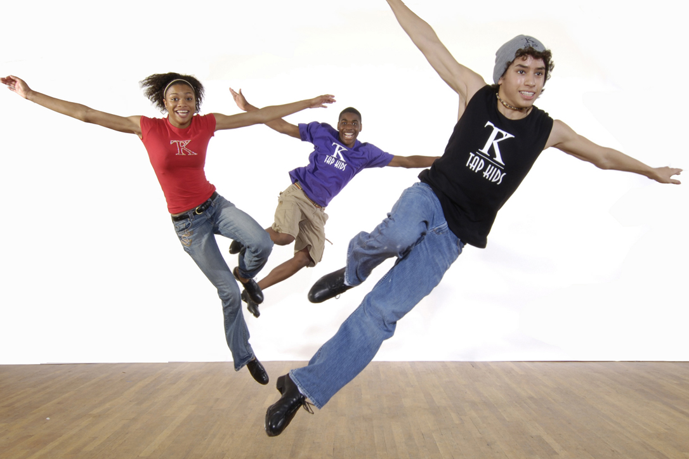
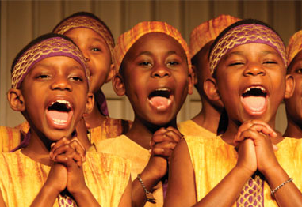
and lung
capacity.

Slide 63

These activities also train and challenge our executive functions
Notes:
will see NDI

Slide 64

They address our social needs, providing feelings of belonging and social support
Notes:
first NDI and then (rather abruptly) youth circus – 2-3 different youth circus groups

Slide 65
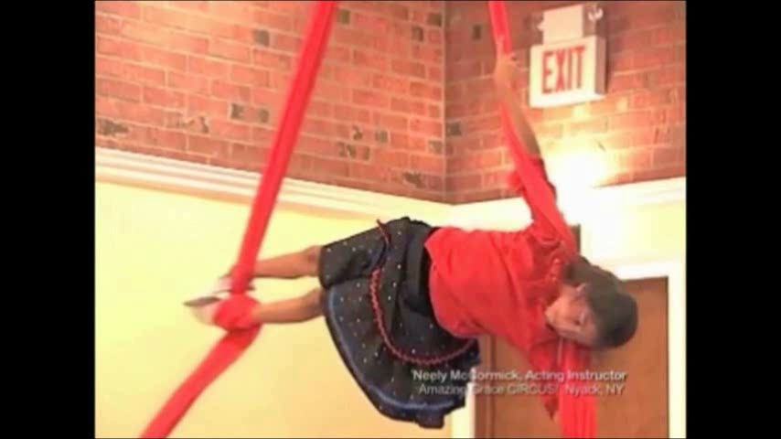
And they provide joy, building children’s feelings of pride and self-confidence
Notes:
first Youth Circus, then El Sistema Orchestra, & finally NDI

Slide 66
Notes:
MUSIC, DANCE, CIRCUS, THEATRE, POSITIVE SPORTS and more
address our physical, cog., emotional, & social needs.

Slide 67
Notes:
Therefore, I PREDICT they should improve EFs.
But it’s only a prediction,
because incredibly
there’s NO solid sci. evidence on the
benefits of any of these activities for EFs.

Slide 68
Notes:
There’s evidence of correlations.
For ex., students in BAND OR SPORTS
often do better in school,
BUT THEY MIGHT HAVE DONE
BETTER IN SCHOOL ANYWAY
even if they hadn’t been in band or sports;
we have no way of knowing.

Slide 69
Notes:
There’s lots of anecdotal data -- testimonials & personal accounts –
that these activities HAVE TRANSFORMED KIDS’ LIVES.
And, there are excellent theoretical reasons,
such as I’ve presented here,
DERIVED FROM SOLID sci. DATA that these activities should help.
But the HARD SCI. EVIDENCE is missing.

Slide 70
Notes:
My grant applications to fund BASIC neuroscience research
(like the role of DA in PFC)
sail thru scientific review &
have been continuously funded by the government for over 25 yrs.

Slide 71
Notes:
But when I request funding
for SOLID research
on the benefits of dance,
music (like el sistema)
– or God forbid, youth circus --
REVIEWERS’ EYES GLAZE OVER.
They say: “STUDY DANCE?? That sounds flaky.”

Slide 72
Notes:
So I’m hoping that people who share my belief
THAT THESE ACTIVITIES
CAN TRANSFORM KIDS’ LIVES
might step forward
TO HELP FUND RESEARCH
to get the SOLID SCI. EVIDENCE.

Slide 73
Notes:
Research showing HARD DATA on the
benefits of these activities for EFs
is sorely needed because these activities
-- the arts, PHYSICAL EXERCISE, and time for play
– are being squeezed out of school curricula TO MAKE TIME FOR more academic instruction.

Slide 74
While it may seem logical that if you want to improve academic outcomes you should concentrate on academic outcomes alone, not everything that seems logical is correct.

Slide 75
Counterintuitively, the most efficient and effective strategy for advancing academic achievement
is probably not to focus only on academics.

Slide 76
We need to care about the whole child (cognitive, social, emotional, and physical)
if we want to improve academic achievement.
If we focus only on academics, we are less likely to succeed.

Slide 77
Notes:
The arts, play, & physical activity
may be critical for ACHIEVING the outcomes
we all want for our children.
thank you

