Slide 1
It is not that children forget the rules.
Indeed, children often call out the correct higher-order rule on trials in the mixed condition (e.g., “same,” “opposite,” “opposite,” “same”) even as they are making errors.
The problem seems to be in quickly translating the rule into the correct response.
Notes:
1
2
2

Slide 2




Dots - Congruent
Dots - Incongruent
Push Left
Push Right
Push Right
Push Left
Notes:
3
3

Slide 3


(Dots Task is the earlier version of the Hearts and Flowers Task)
Dots Task: Accuracy
100
Congruent
Incongruent
Mixed
90
80
Percent Correct
70
60
Adults
4
5
6
6
7
8
9
10
11
13
26
Stimuli presented for 2500 ms Stimuli presented for 750 ms
Age in Years
Davidson et al. (2006). Neuropsychologia, 44, 2037 - 2078

Slide 4
Dots Conditions: Accuracy
100
Congruent
Incongruent
Mixed
90
80
Percent Correct
70
60
4
5
6
6
7
8
9
10
11
13
26
Stimuli presented for 2500 ms Stimuli presented for 750 ms
Age in Years
Davidson et al. (2006). Neuropsychologia, 44, 2037 - 2078

Slide 5
SWITCHING –
re-setting one’s attentional focus, re-orienting one’s mindset --
is what most difficult & when DL-PFC is most critically required.

Slide 6
Increased Activation of
Dorsolateral PFC (Area 46/9)
Dots-Mixed minus Dots-Congruent
R
L
p<.01
Talairach:
(-40, 45,28)
Talairach:
(34, 45,25)
p<.001
p<.0001

Slide 7
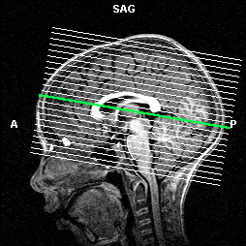
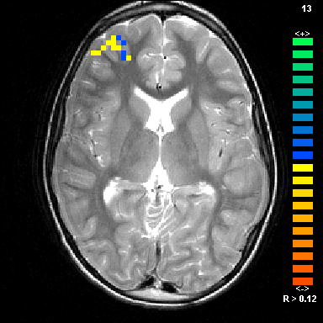
JK slice 13
Dots-Mixed
minus
Dots-Congruent
10-year-olds
Notes:
Slice No. 13

Slide 8
Dots Task: Accuracy
100
Congruent
Incongruent
Mixed
90
80
Percent Correct
At every age studied, children were slower & less accurate on the Flower block than on the Heart block.
70
60
4
5
6
6
7
8
9
10
11
13
26
Stimuli presented for 2500 ms Stimuli presented for 750 ms
Age in Years
That effect is completely absent in adults.

Slide 9

Even very young children have excellent memories. Inhibition is a far greater challenge for them than holding information in mind.

Slide 10


Abstract Figures - Center Presentation
Push Left
Push Right
Notes:
10
1
3

Slide 11
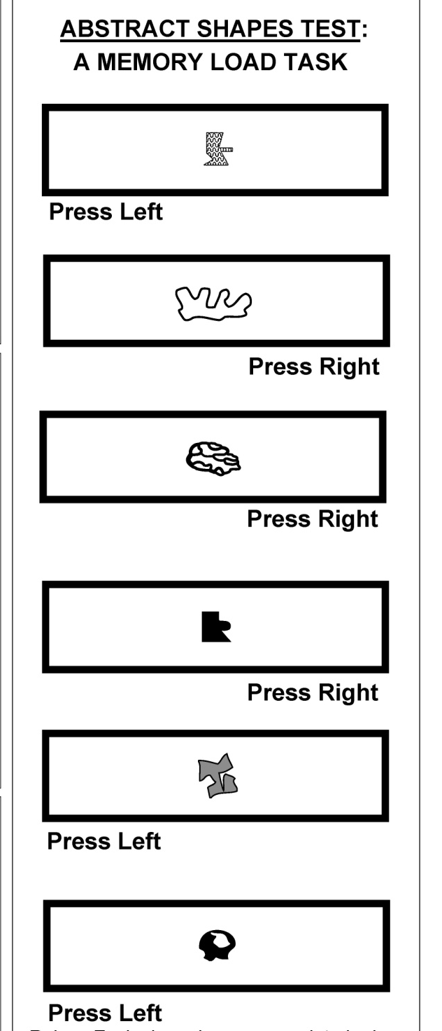

Slide 12
Increasing demands on INHIBITION (the Flower block vs. the Heart block) are more difficult for young children (ages 4-9 years) than increasing demands on how much information they must hold in mind (2 to 6 items).

Slide 13
The opposite is true for us adults:
Increasing MEMORY demands is far more difficult for us than increasing demands on inhibition.

Slide 14

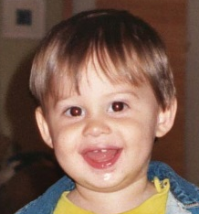




We adults may not appreciate how inordinately difficult inhibition is for young children because it is so much less taxing for us.

Slide 15
Remember
Working Memory & just holding information in mind (Short-Term Memory) are distinct.

Slide 16




Incongruent
Trials
Congruent
Trials
Push Left
Push Right
Push Right
Push Left
A Classic Simon Task
Notes:
2
2

Slide 17

A Simon Task
The Rules are:
Whenever you see a BUTTERFLY, press LEFT.
Whenever you see a FROG, press RIGHT.
Notes:
2
2

Slide 18
Dots - Congruent
Dots - Incongruent
Push Left
Push Right
Push Right
Push Left
Notes:
3
3

Slide 19
Whenever you see a Gray Disc, press on the SAME side as the stimulus.
Whenever you see a B&W Striped Disc, press on the side OPPOSITE the stimulus.
Requires the extra step of mentally translating same/opposite into Left or Right.

Slide 20
Comparison of Mixed Conditions
of Hearts-Flowers and Simon
in Percentage of Correct Responses
Simon- jMixed
Dots- Mixed
100
90
80
Percent Correct
70
60
50
4
5
6
6
7
8
9
10
11
13
26
Age in Years
Stimuli presented for 2500 ms Stimuli presented for 750 ms
Davidson et al. (2006). Neuropsychologia, 44, 2037 - 2078

Slide 21

The Tools of the Mind early childhood program, based on theories of Vygotsky and Luria
Elena Bodrova & Deborah Leong

Slide 22
Deb and Elena tried EF activities as a module, added onto a curriculum.
They found that children improved on what they practiced in the module, but the benefits did not transfer to other contexts or other EF skills.

Slide 23
They found that for benefits to generalize to other contexts and other EF skills, supports for, training in, and challenges to EF needed to be embedded in all aspects of the school day.
not only increases amount of time practicing but also varies type of practice

Slide 24
For Our Study: Both conditions involved…
new programs, instituted at the same time.
the same books, classroom set-up, toys, & materials.
the same amount of in-classroom coaching support, same # of professional development hours, and same teacher stipends for attending workshops.
the same curricular content and covered the same topics.

Slide 25
Teachers & teaching assistants were randomly assigned to condition, stratified by level of education & amount of time teaching.

Slide 26
All children came from the same neighborhood, and children in Tools and the district-curriculum were closely matched.

Slide 27
In evaluatingTools we specifically chose EF measures completely different from anything any of the children had ever done before.
To see a difference by condition, the children would have to TRANSFER their training in EF to utterly new situations.

Slide 28


HEARTS & FLOWERS
Congruent
Incongruent
Push Left
Push Right
Push Right
Push Left
Notes:
28
3
3

Slide 29

Notes:
29
3
3

Slide 30
Percentage of Correct Responses on
the Dots Task - Incongruent Block (Flowers)
by 5-year-old children
90
85
80
75
70
65
60
Percent Correct
55
50
45
Significant but tiny
40
35
30
District Curriculum
Tools of the Mind

Slide 31
Mixed Block (Hearts & Flower Trials Intermixed)
Percent of Children who Passed Criterion for Testing
60
55
Almost 2x as many in Tools passed practice
50
Percent Passing
45
40
35
30
25
District Curriculum
Tools of the Mind

Slide 32
Whether children were in Tools of the Mind or not accounted for more variance in EF than did age or gender.

Slide 33
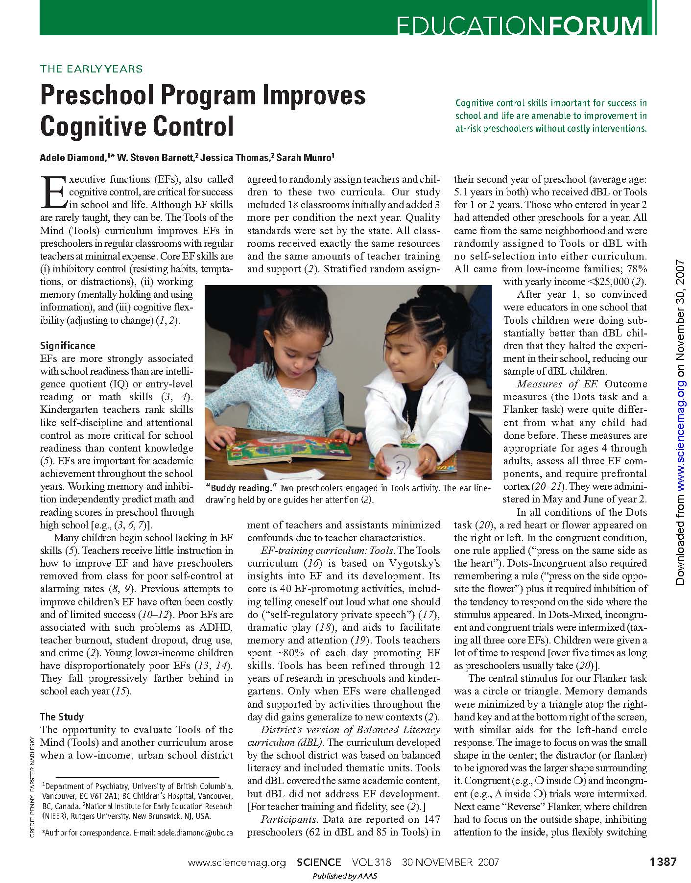
November 30, 2007
(Executive Functions)

Slide 34
Wright, A. & Diamond, A. (2014). An effect of inhibitory load in children while keeping working memory load constant. Frontiers in Psychology, 5, 1-9. (Special issue on Development of Executive Function during Childhood).
Schonert-Reichl, K. A., Oberle, E., Lawlor, M. S., Abbott, D., Thomson, K., Oberlander, T., & Diamond, A. (accepted). Accelerating the development of executive functions and empathy: Effects of a school-based program. Developmental Psychology (Special Section on Mindfulness and Compassion in Human Development).
Blair, C., & Raver, C. (2014). Closing the achievement gap through modification of neurocognitive and neuroendocrine function: Results from a cluster randomized controlled trial of an innovative approach to the education of children in kindergarten. PLoS One, 9, e112393.

Slide 35
Davidson, M.C. T, Amso, D. T, Anderson, L.C. T, & Diamond, A. (2006). Development of cognitive control and executive functions from 4-13 years: Evidence from manipulations of memory, inhibition, and task switching. Neuropsychologia, 44, 2037 – 2078.
Zaitchik, D., Iqbal, Y., & Carey, S. (2014). The effect of executive function on biological reasoning in young children: An individual differences study. Child Development, 85, 160-175.
Edgin, J. O., Mason, G. M., Allman, M. J., Capone, G. T., DeLeon, I., Maslen, C., . . . Nadel, L. (2010). Development and validation of the Arizona Cognitive Test Battery for Down syndrome. Journal of Neurodevelopmental Disorders, 2, 149-164.
Diamond, A., Barnett, W. S., Thomas, J., & Munro, S. (2007). Preschool program improves cognitive control. Science, 318, 1387-1388.

